Slide 2
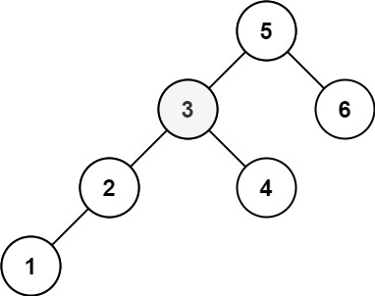
0 | 1 | 2 | 3 | 4 | 5 | 6 | 7 | 8 | 9 | 10 | 11 | 12 | 13 | ...
5
index

Slide 3
0 | 1 | 2 | 3 | 4 | 5 | 6 | 7 | 8 | 9 | 10 | 11 | 12 | 13 | ...
5 | 3
index

Slide 4
0 | 1 | 2 | 3 | 4 | 5 | 6 | 7 | 8 | 9 | 10 | 11 | 12 | 13 | ...
5 | 3 | 2
index

Slide 5
0 | 1 | 2 | 3 | 4 | 5 | 6 | 7 | 8 | 9 | 10 | 11 | 12 | 13 | ...
5 | 3 | 2 | 1
index

Slide 6
0 | 1 | 2 | 3 | 4 | 5 | 6 | 7 | 8 | 9 | 10 | 11 | 12 | 13 | ...
5 | 3 | 2 | 1 | 4
index

Slide 7
0 | 1 | 2 | 3 | 4 | 5 | 6 | 7 | 8 | 9 | 10 | 11 | 12 | 13 | ...
5 | 3 | 2 | 1 | 4 | 6
index

Slide 8
Qsort()
0 | 1 | 2 | 3 | 4 | 5 | 6 | 7 | 8 | 9 | 10 | 11 | 12 | 13 | ...
1 | 2 | 3 | 4 | 5 | 6
index

Slide 9
k=3
0 | 1 | 2 | 3 | 4 | 5 | 6 | 7 | 8 | 9 | 10 | 11 | 12 | 13 | ...
1 | 2 | 3 | 4 | 5 | 6
index

Slide 11
When k = 3
Last 3
[3,5]
Last 1
[4,5]
Last 2

Slide 12
When k = 3
[3,4]
Last 2
[2,3]
Last 1
Last 3

Slide 13
When k = 3
Last 3
[2,3]
Last 2
[1,3]
Last 1

